Slide 1
IFS4102 Digital Forensics
Case Presentation
Group 6
By: Wellington Customs Forensic Department
Investigators: Ang Yong Ming, Hrithie Menon, Ibrahim Sharul, Teo Chuan Kai
Notes:
IFS4102 Digital Forensics
Case Presentation
Good morning Senior management (Customs), my team and I, consisting of YM, Hrithie, Chuan Kai and myself are from the Wellington Customs Forensic Department and we will be sharing our findings on the case in hand, regarding the drug bust

Slide 2
Table of contents
01
02
Overview
Narcos 2
03
04
Narcos 3
Analysis & Conclusion
Who we are and our objective
Evidence and findings
Evidence and findings
Answering key questions
Notes:
We will be covering :
Purpose and what we hope to explain
Explain the evidence we found
Our analysis of the lingering questions

Slide 3
Our Role
Analyse evidence of the seized laptops
Further understand motives, goals and objectives of
John Fredricksen
Suspect, who is determined to be Steve Kowhai
Jane Esteban
Present case findings to Customs’ management and in court
Notes:
We were tasked to analyse further evidence from the 2 seized laptops
And understand the motives, goals and objectives from John Fredriksen, the suspect whom we determined to be Steve Kowhai from Case 1 and Jane Esteban
And communicate our findings to Custom’s management and subsequently in court

Slide 4
Questions pending answers
Who was Jane actually?
What did John think of Jane, and what did he want from her?
Who were the guilty parties in the overall case based on the extra evidence given?
What were the guilty parties’ future plans and intentions based on the extra evidence
Notes:
Specifically, we were tasked to answer the following qns regarding Jane, the relationship between John and Jane and the future plans of the guilty parties

Slide 5
Brief answers to questions
Question | Brief Answer
1. Who was Jane actually? | An undercover Australian Police Officer
2. What did John think of Jane, and what did he want from her? | A vulnerable individual who could be used to orchestrate a facade of a couple on holiday to evade detection
3. Who were the guilty parties in the overall case based on the extra evidence given? | Steve Kowhai and John Fredricksen
4. What were the guilty parties’ future plans and intentions based on the extra evidence | Steve Kowhai Scaling up deliveries of Meth John Fredricksen Continue trafficking drugs
Notes:
Here is a summary of our answers, which we will go into detail hereinafter
Essentially, Jane was actually an undercover Australian Police officer who was seen as vulnerable and was used as a cover for John to come here and give the drugs
We find Steve Kowhai and John Fredriksen guilty for scaling up drug trading and drug trafficking respectively

Slide 6
Overview of case
Intelligence from the Australian government led to the interception of John Fredricksen and Jane Esteban upon their arrival in Wellington, New Zealand from Brisbane.
During a search, one kilogram of Methamphetamine was found in John Fredricksen's suitcase.
Additional evidence provided by Customs officers: images and memory dumps of two seized laptops.
Initial uncertainty regarding Jane Esteban's role and guilt.
Further forensic examination of the new evidence to understand the motives, relationship and future intentions of Fredricksen, Esteban, and Kowhai.
Notes:
Lets go through the case details again

Slide 7
Findings from Case 1
Steve Kowhai, our suspect, who goes by the username “crayfish1980” communicated with John Fredricksen via discord to arrange for a delivery of Methamphetamine to Eastbourne Library or alternatively, 666 Rewera Avenue.
Many evidence found pointing to Steve’s intention to buy and resell drugs on a larger scale and money launder
Potential presence of encrypted contents and a unrecoverable deleted memo document found
Notes:
Deliver to 1 of 2 locations - Estbourne Library or 666 Rewera Avenue

Slide 8
Methodology
Evidence Acquisition: Obtained computer drive images from customs officers.
Chain of Custody Management: Signed and maintained a chain of custody form for each acquired drive image.
Integrity Verification: Combined the acquired drive image files and verified their hash values using powershell to ensure integrity and detect any potential tampering
Examination Utilizing Forensic Tools: Employed forensic tools such as Autopsy to systematically analyze the entire drive image for suspicious files, artifacts, and potential evidence.

Slide 9
Evidence Analysed
No | File Name | SHA1 Checksum | Size
1 | Narcos-2.img | 576d20ffc835d98724e472c1714eaecff37f13d1 | 30 GB
2 | Narcos-Mem-2.raw | 3d6f1ff3e3d61b42837a7ebf0ffe058433c6282f | 4 GB
3 | Narcos-3.img | 57c9a704b09fbb50118da57f62546824e062a73a | 30 GB
4 | Narcos-Mem-3.raw | 90b3d8ba9e96373c96ee9460193c1b585eadb009 | 4 GB

Slide 10


Overview of 2 computers seized
John Fredricksen
Jane Esteban
Operating System | Drive
Name: JOHNFLAPTOP1 Version: Windows 10 Pro Processor Architecture: AMD64 Product ID: 00330-80000-00000-AA310 Owner: JohnF | Type: Image Size: 32212254720 bytes (30.0GB) Sector Size: 512 bytes Device ID: b6ef7f3b-8930-4671-8133-d8a69df8774e
Operating System | Drive
Name: JELAPTOP Version: Windows 10 Pro Processor Architecture: AMD64 Product ID: 00330-80000-00000-AA263 Owner: Windows User | Type: Image Size: 32212254720 bytes (30.0GB) Sector Size: 512 bytes Device ID: 016e41e0-c13e-453c-9b95-a886aa80fb28

Slide 11
Drive Information
John Fredricksen
Name | Description | Starting Sector | Ending Sector | Length in Sectors | Flags
vol1 | Unallocated | 0 | 2047 | 2048 | Unallocated
vol4 | Basic data partition | 2048 | 1023999 | 1021952 | Allocated
vol5 | EFI System partition | 1024000 | 1226751 | 202752 | Allocated
vol6 | Microsoft reserved partition | 1226752 | 1259519 | 32768 | Allocated
vol7 | Basic data partition | 1259520 | 62912511 | 61652992 | Allocated
vol8 | Unallocated | 62912512 | 62914559 | 2048 | Unallocated

Slide 12
Drive Information
Jane Esteban
Name | Description | Starting Sector | Ending Sector | Length in Sectors | Flags
vol1 | Unallocated | 0 | 2047 | 2048 | Unallocated
vol4 | Basic data partition | 2048 | 1023999 | 1021952 | Allocated
vol5 | EFI System partition | 1024000 | 1226751 | 202752 | Allocated
vol6 | Microsoft reserved partition | 1226752 | 1259519 | 32768 | Allocated
vol7 | Basic data partition | 1259520 | 62912511 | 61652992 | Allocated
vol8 | Unallocated | 62912512 | 62914559 | 2048 | Unallocated

Slide 13
Forensic Tools Used
Name | Version
Autopsy | 4.21.0
Volatility 3 Framework | 2.7.0
Windows Powershell | 5.1.22621.2506
ChromeHistoryViewer | 1.53
MZHistoryView | 1.70
TheSleuthKit | 4.12.1
Image Steganography | 1.5.2
TrueCrypt | 7.1a

Slide 14
Search Terms used in Autopsy
John
Jane
Methamphetamine
Drugs
Eastbourne
666 Rewera
Wellington
crayfish1980
Steve kowhai
heresjohnny1
Elchapo2
crayfish1980
becomingjane

Slide 15
John Fredricksen’s computer
Narcos-2

Slide 16






User Installed Programmes
Apache OpenOffice
Baidu Antivirus
Discord
Image Steganography
Mozilla Firefox
TrueCrypt
Open-source word processing application
Host-based anti-malware solution offered by Baidu.
Instant messaging and voice over IP (VoIP) social platform
Program which allows users to embed text and files in images
Web browser by Mozilla Foundation
Open-source utility to encrypt partitions or whole storage devices

Slide 17
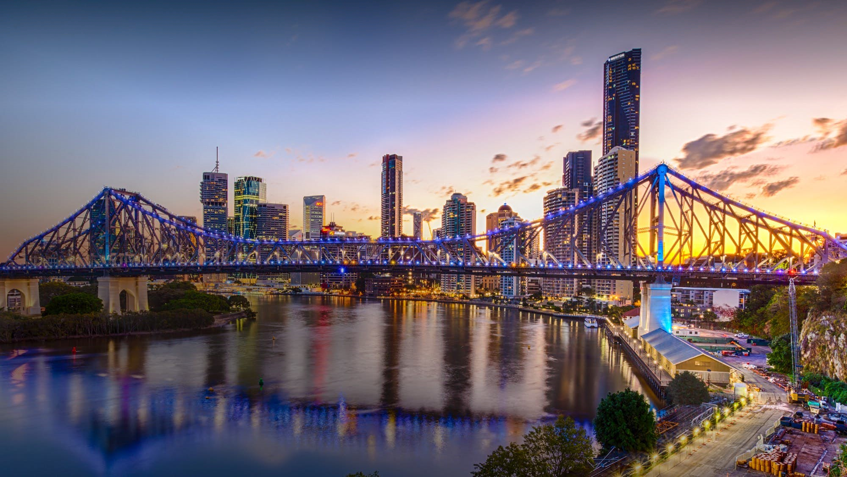
Exhibit A1: BNE.png
Same picture as in Case 1 of Brisbane sent from John to Steve; Image hidden inside with password “Elchapo2” titled “Package.jpg” (Exhibit A5)

Slide 18
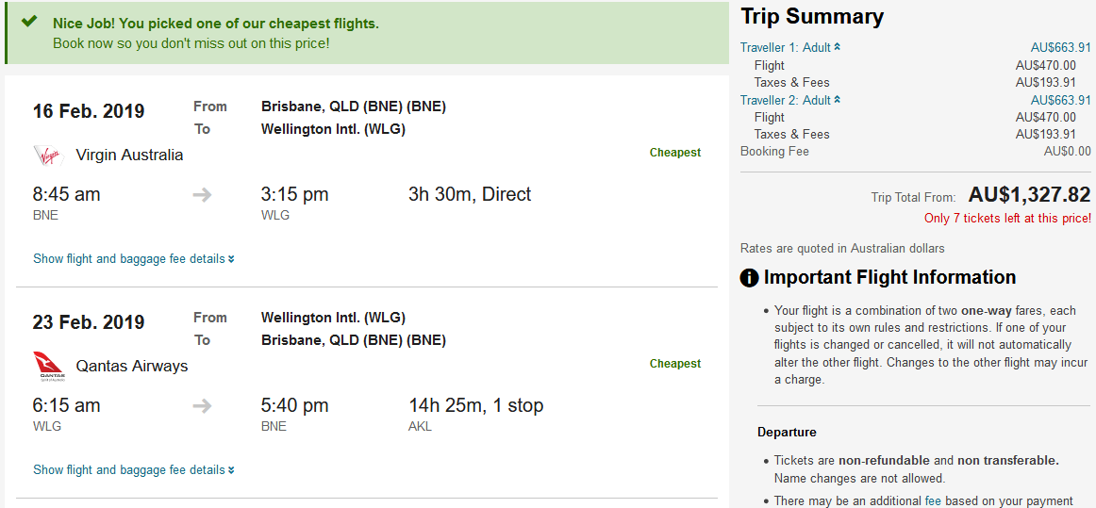
Exhibit A2 (Steve K.PNG)
Trip summary of return flights booking from Brisbane for 2 (Same as in Case 1); John and Jane. Fredricksen communicated this to Steve and Jane

Slide 19
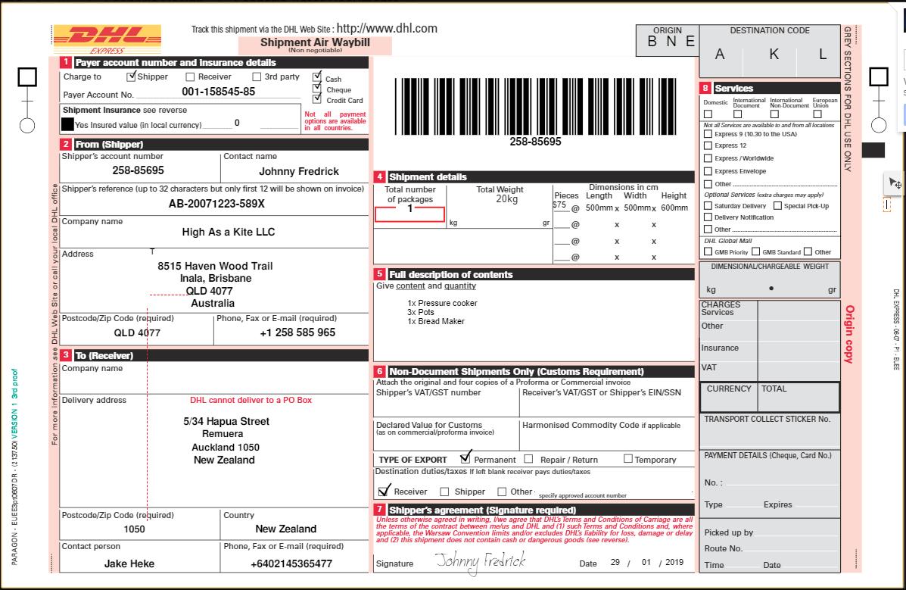
Exhibit A3 (shipping.PNG)
Different name
Likely fake company name
Inala address - John is from here
1 of John’s clients in client list

Slide 20
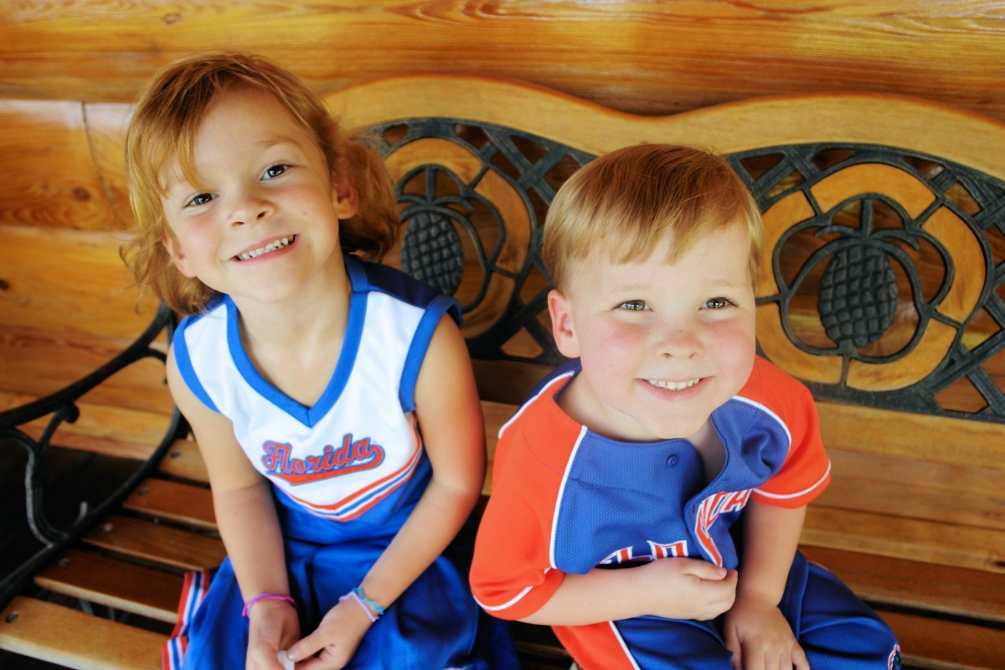
Exhibit A4 (Janes Kids.jpg)
A picture of Jane Esteban Kids, used to blackmail her in Exhibit A12 (Discord Chat Logs)

Slide 21
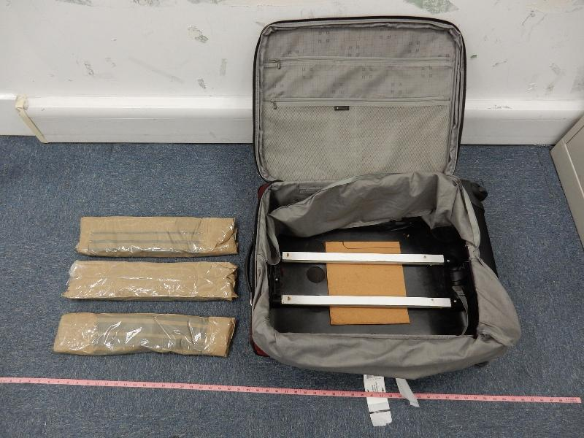
Exhibit A5 (package.jpg)
Picture hidden in Exhibit A1: BNE.png showing where drugs will be hidden, sent to Steve for him to retrieve “the package” later

Slide 22
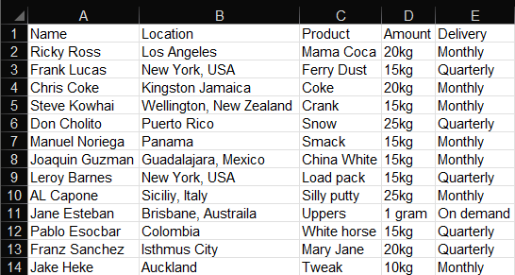
Exhibit A6 (clients.ods)
Different types of drugs
Under his business folder is this document contains the name of several individuals, their locations, products, amounts and frequency of delivery; The products seem to be colloquial terms for different type of drugs

Slide 23

Exhibit A7 (Attachments-Important, crucial to our method.zip)
Downloads folder of John, downloaded as an attachment from John Fredricksen’s ProtonMail account, as elaborated in Exhibit A13 (ProtonMail Account), title indicative of something substantial

Slide 24

Exhibit A8 (secret)
File found in zip archive, similar name to Possible Presence of Encrypted Contents in Case 1. Found to be encrypted file using password “ilovediving”. Steve sent it to John and deleted it immediately (Case 1)

Slide 25
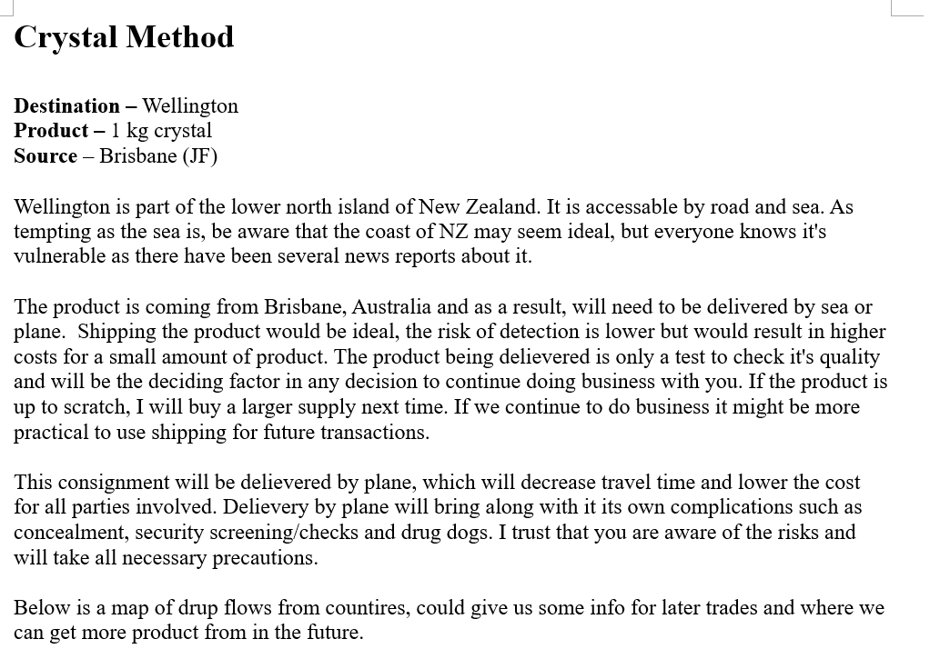
Exhibit A9 (Memo Things.odt)
John Fredricksen
Extracted from secret encrypted volume; Tells details of operation to transport 1kg of crystal (ice) from Brisbane to Wellington.

Slide 26
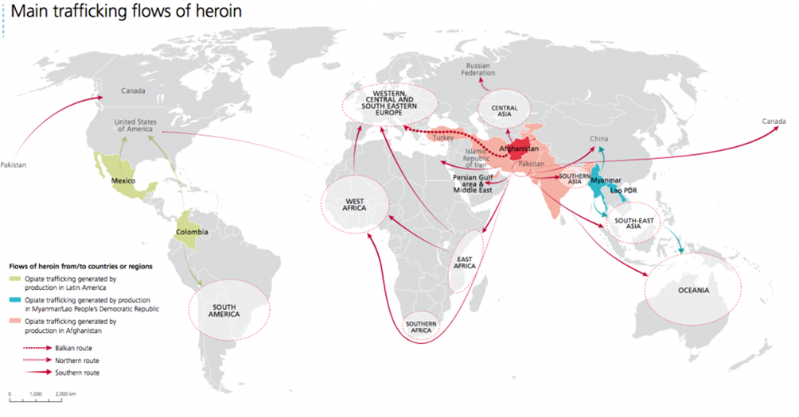
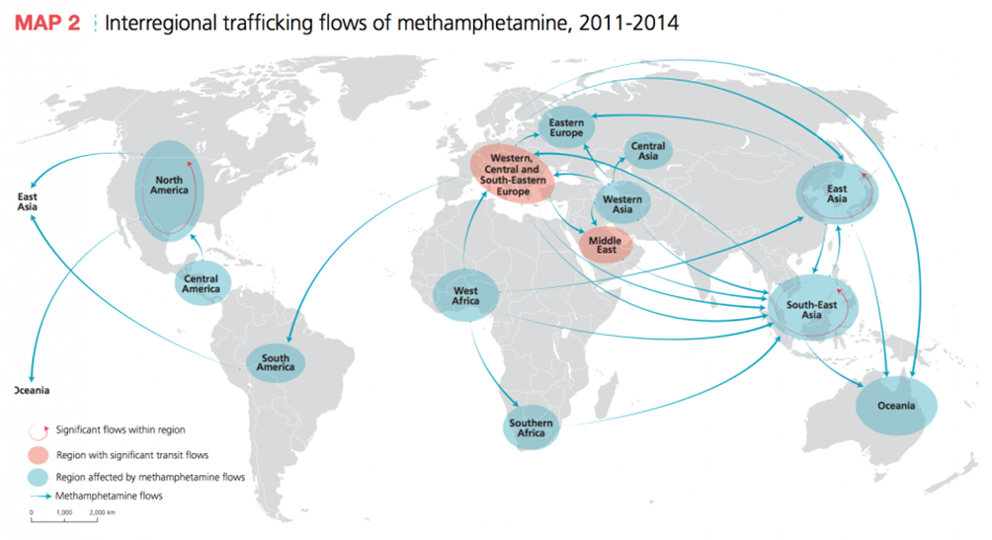
Exhibit A9 (Memo Things.odt)
Shows details of how their drug trafficking operations worldwide

Slide 27
Exhibit A10 (Contact_Card.zip)
Found in Downloads folder, sent by Jane Esteban via Discord from Exhibit A12 (Discord Chat Logs) and downloaded by John

Slide 28

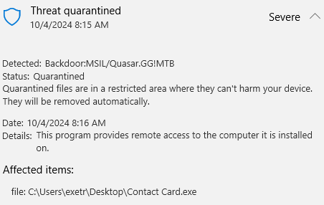
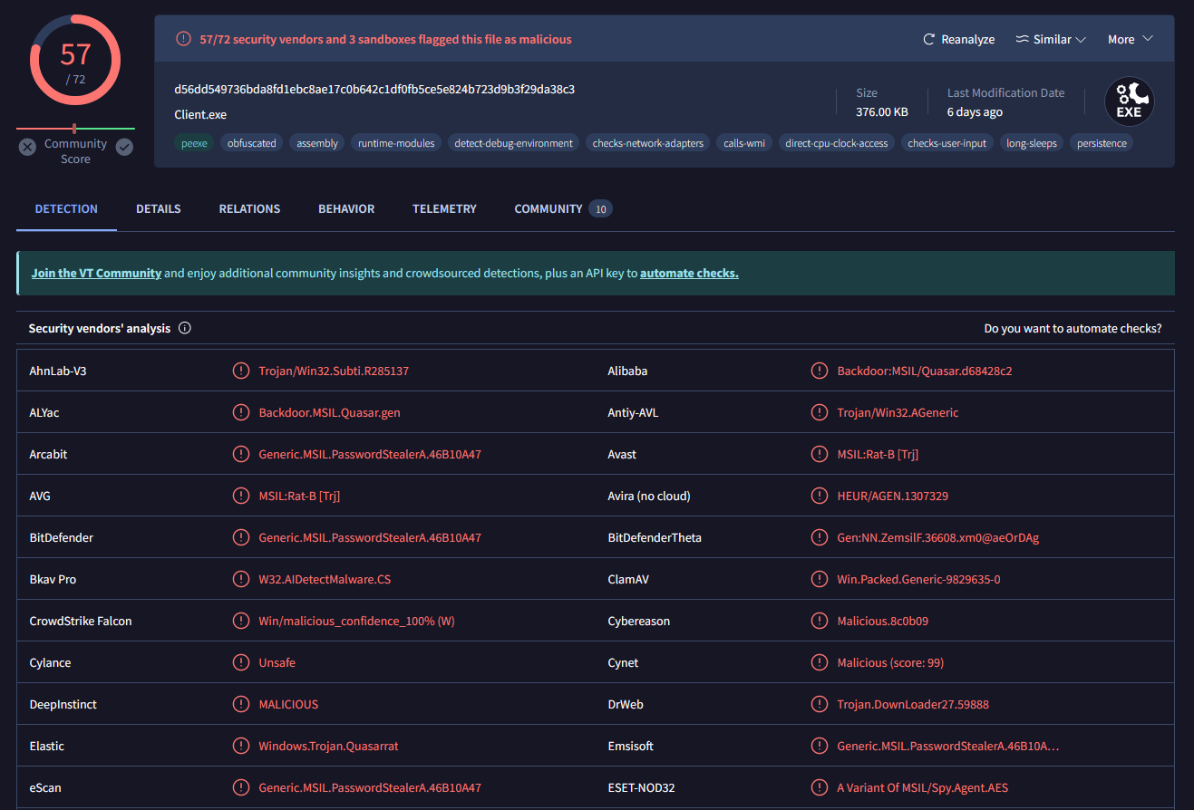
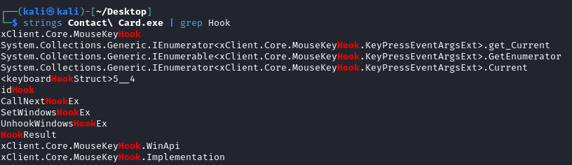
Exhibit A11 (Contact Card.exe)
A known malware with Remote
Administration tool (with
keylogger) activated

Slide 29
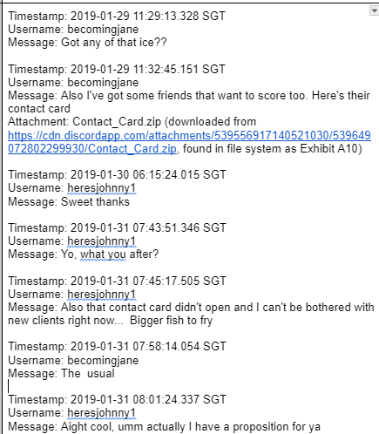
Exhibit A12 (Discord Chat Logs) - Deleted
Conversation between John and Jane,
Contact_Card zip sent

Slide 30
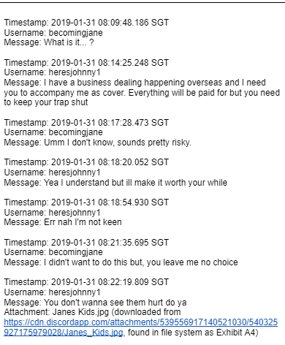
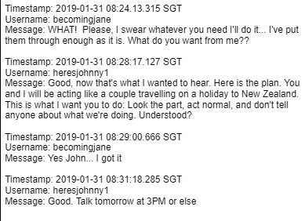
Exhibit A12 (Discord Chat Logs)
Blackmailed Jane and being forced to follow
her as a cover

Slide 31
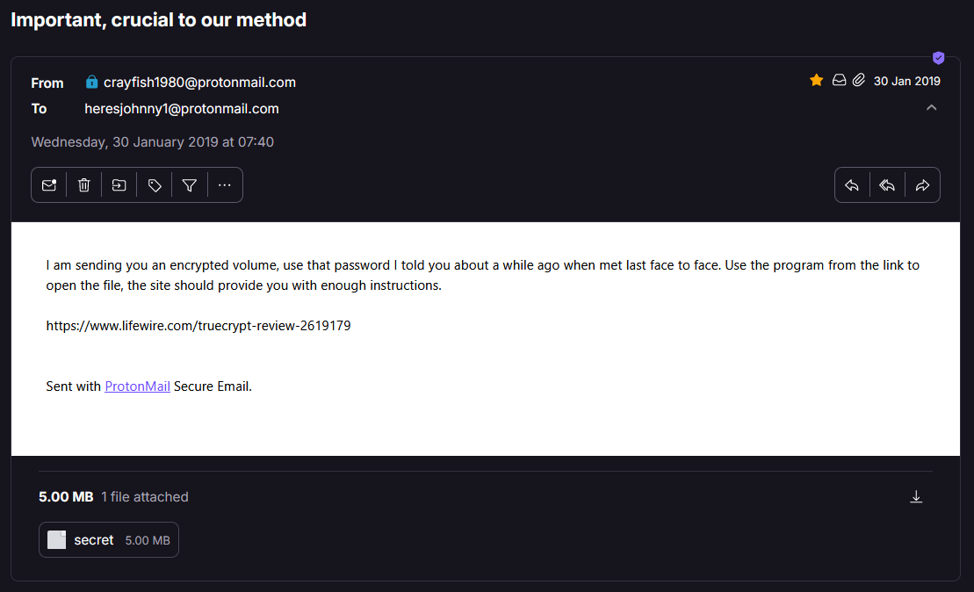
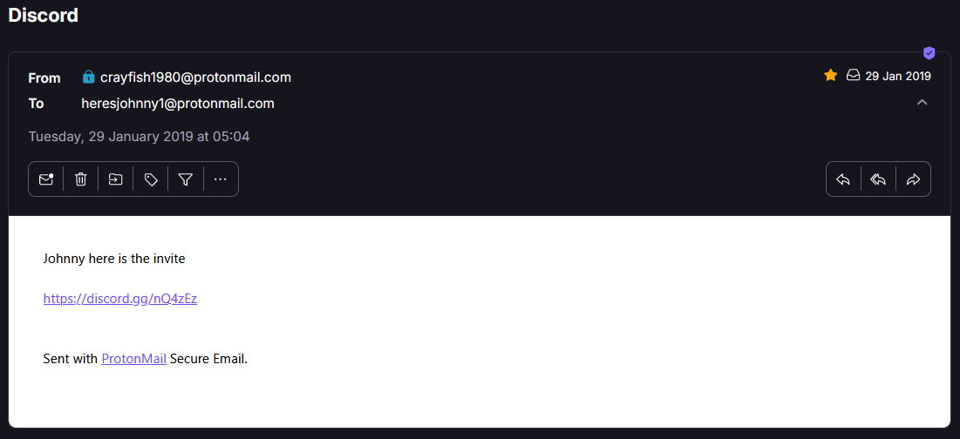
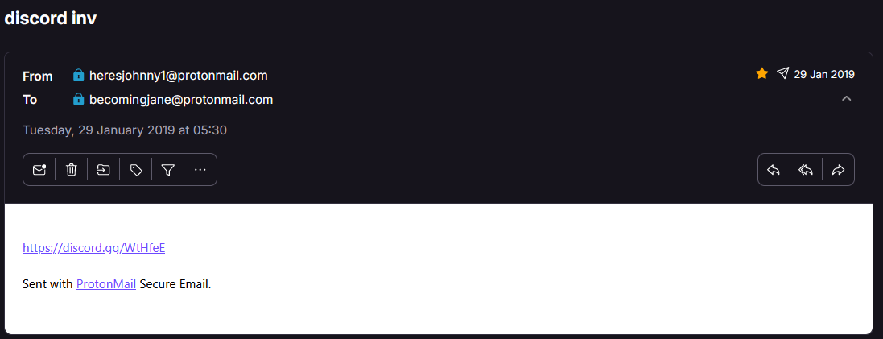
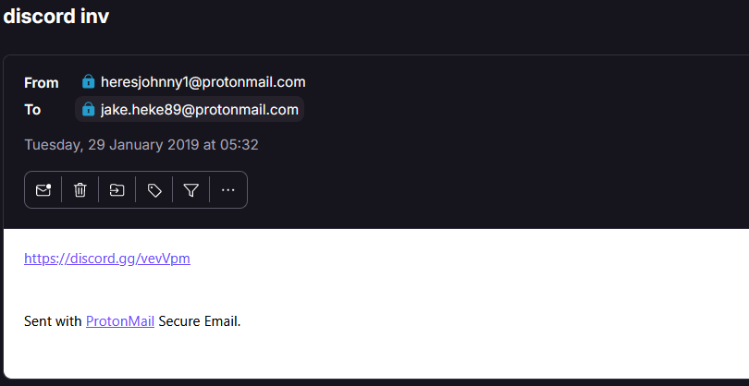
Exhibit A13 (ProtonMail Account)
Sent route and encrypted volume, as in Exhibit A8

Slide 32
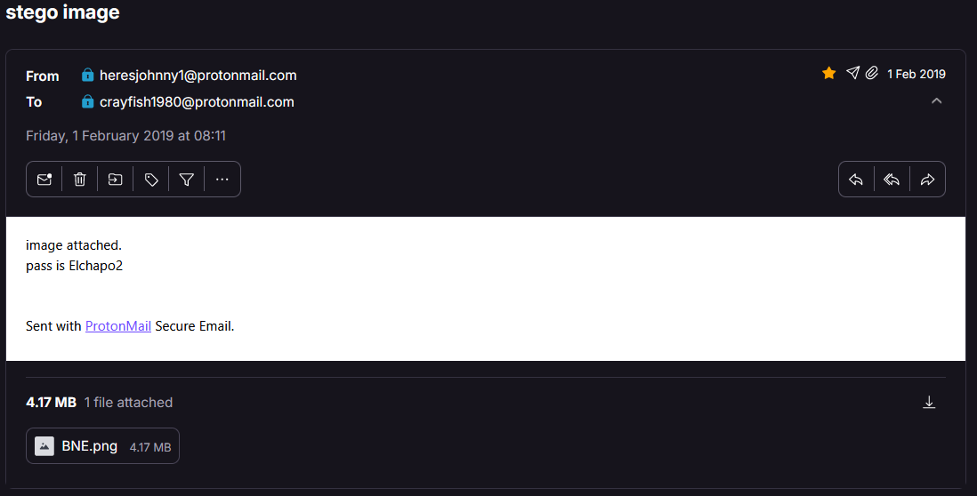
Exhibit A13 (ProtonMail Account)
Password to the Image Steganography in Exhibit A1 (BNE.png)

Slide 33
Exhibit A14 (Microsoft Edge History)
Items of Interest in Search History
firefox (via google.com.au)
2 instances (2019-01-28 20:08:33 SGT, 2019-01-28 20:08:34 SGT)
protonmail (via bing.com)
6 instances (between 2019-01-28 21:12:28 SGT and 2019-01-29 02:10:47 SGT)
how to cut drugs (via bing.com)
4 instances (between 2019-01-28 23:01:55 SGT and 2019-01-28 23:02:18 SGT)

Slide 34
Exhibit A14 (Microsoft Edge History)
Items of Interest in Search History:
how to cut drugs (via youtube.com)
2 instances (2019-01-28 23:03:06 SGT, 2019-01-28 23:03:07 SGT)
cutting drugs (via youtube.com)
2 instances (2019-01-28 23:04:24 SGT)
how to launder money (via bing.com)
2 instances (2019-01-28 23:07:36 SGT, 2019-01-28 23:10:30 SGT)
drugs subreddit (via bing.com)
4 instances (between 2019-01-28 23:13:20 SGT and 2019-01-28 23:17:29 SGT)
dhl (via bing.com)
2 instances (2019-01-29 03:43:19 SGT, 2019-01-29 03:49:16 SGT)
Likely associated with shipping label found as part of Exhibit A3 (shipping.PNG)
shipping companies for packaging (via bing.com)
2 instances (2019-01-29 03:49:16 SGT)
Likely associated with shipping label found as part of Exhibit A3 (shipping.PNG)
shipping companies for packaging au (via bing.com)
2 instances (2019-01-29 03:49:20 SGT, 2019-01-29 03:51:38 SGT)
Likely associated with shipping label found as part of Exhibit A3 (shipping.PNG)
harvey norman pressure cooker au (via bing.com)
2 instances (2019-01-29 03:52:03 SGT)
Likely associated with objects stated in shipping label found as part of Exhibit A3 (shipping.PNG)

Slide 35
Exhibit A14 (Microsoft Edge History)
Items of Interest in Search History:
dhl (via bing.com)
2 instances (2019-01-29 03:43:19 SGT, 2019-01-29 03:49:16 SGT)
Likely associated with shipping label found as part of Exhibit A3 (shipping.PNG)
shipping companies for packaging (via bing.com)
2 instances (2019-01-29 03:49:16 SGT)
Likely associated with shipping label found as part of Exhibit A3 (shipping.PNG)

Slide 36
Exhibit A14 (Microsoft Edge History)
Items of Interest in Search History:
shipping companies for packaging au (via bing.com)
2 instances (2019-01-29 03:49:20 SGT, 2019-01-29 03:51:38 SGT)
Likely associated with shipping label found as part of Exhibit A3 (shipping.PNG)
harvey norman pressure cooker au (via bing.com)
2 instances (2019-01-29 03:52:03 SGT)
Likely associated with objects stated in shipping label found as part of Exhibit A3 (shipping.PNG)

Slide 37
Exhibit A15 (Mozilla Firefox History)
Items of Interest in Search History
baidu anti-virus download (via google.com)
1 instance (2019-01-29 04:15:55 SGT)
Related to download and install of the Baidu AntiVirus program
openoffice (via google.com)
1 instance (2019-01-29 04:18:29 SGT)
Related to download and install of the OpenOffice program
discord (via google.com)
1 instance (2019-01-29 04:20:46 SGT)
Related to download and install of Discord
encryption methods youtube (via google.com)
1 instance (2019-01-29 04:49:46 SGT)
drug detector dogs (via google.com)
1 instance (2019-01-31 10:01:30 SGT)
suitcase concealments (via google.com)
3 instances (2019-01-31 10:04:44 SGT to 2019-01-31 10:05:21 SGT)
suitcase concealments for drugs (via google.com)
3 instances (2019-01-31 10:06:09 SGT to 2019-01-31 10:12:48 SGT)
flights brisbane to WLG return (via google.com)
1 instance (2019-01-31 10:15:43 SGT)
steganography image download (via google.com)
2 instances (2019-02-01 05:29:24 SGT, 2019-02-01 05:29:27 SGT)
Flights from brisbane to wellington au
1 instance (2019-02-02 06:40:45 SGT)
directions from Inala to brisbane airport
1 instance (2019-02-02 10:46:16 SGT)

Slide 38
Exhibit A15 (Mozilla Firefox History)
Items of Interest in Search History
encryption methods youtube (via google.com)
1 instance (2019-01-29 04:49:46 SGT)
drug detector dogs (via google.com)
1 instance (2019-01-31 10:01:30 SGT)
suitcase concealments (via google.com)
3 instances (2019-01-31 10:04:44 SGT to 2019-01-31 10:05:21 SGT)
suitcase concealments for drugs (via google.com)
3 instances (2019-01-31 10:06:09 SGT to 2019-01-31 10:12:48 SGT)
flights brisbane to WLG return (via google.com)
1 instance (2019-01-31 10:15:43 SGT)
steganography image download (via google.com)
2 instances (2019-02-01 05:29:24 SGT, 2019-02-01 05:29:27 SGT)
Flights from brisbane to wellington au
1 instance (2019-02-02 06:40:45 SGT)
directions from Inala to brisbane airport
1 instance (2019-02-02 10:46:16 SGT)
Research to evade crime

Slide 39
Exhibit A15 (Mozilla Firefox History)
Items of Interest in Search History
flights brisbane to WLG return (via google.com)
1 instance (2019-01-31 10:15:43 SGT)
steganography image download (via google.com)
2 instances (2019-02-01 05:29:24 SGT, 2019-02-01 05:29:27 SGT)
Flights from brisbane to wellington au
1 instance (2019-02-02 06:40:45 SGT)
directions from Inala to brisbane airport
1 instance (2019-02-02 10:46:16 SGT)
To hide package details of where drugs are stored
Shows where John might be from

Slide 40
Jane Esteban Computer
Narcos-3

Slide 41

User installed Programmes
Quasar
Discord
Light-weight remote administration tool with RDP and keylogging features
Instant messaging and voice over IP (VoIP) social platform for communication

Slide 42

Exhibit B1 (afp.png) - Deleted
A badge of the Australian Federal Police

Slide 43

Exhibit B2 (background.png)
A badge, along with the title of the Australian Federal Police

Slide 44

Exhibit B3 (contact-card-512.png)
A clip art of contact-card, used by Jane to change the icon of the Quasar Keylogger to this Contact card image so that John would unknowingly execute it

Slide 45
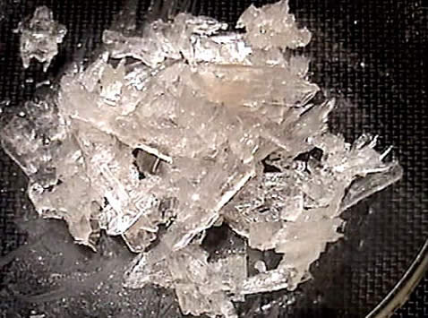
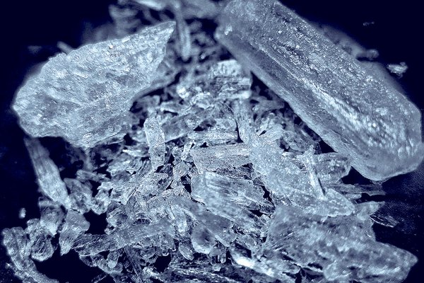
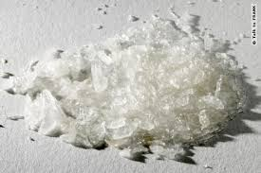
Exhibit B4 (crys1.jpg), B5 (crys2.jpg),
B6 (crys3.jpg)
Image of what we suspect to be Methamphetamine crystals, likely used by Jane for her research into drug trafficking

Slide 46

Exhibit B7 (course-undercover-survival.pdf)
Found in her documents, outline for a law enforcement in-service training course offered by Schoolcraft College’s Public Safety Training Center titled “Undercover Survival and Lawful Invasions”.
Shows that she might be an undercover officer when combined with Police badge and with her search history

Slide 47
Exhibit B8 (01-30-2019.html) - Keylogger
Event (time): #general - Discord (08:14)
Sweet thanks [Enter]
Got a new supplier. Ya Interested??[Enter]
Hmm 10 is abit much for the first time around and is pretty risky. How about we start off with 1 and can ramp up from there if all goes smoothly?[Enter]
Event (time): Start - Microsoft Edge (09:56)
protonmail.com[Enter]
Event (time): Login | ProtonMail - Microsoft Edge (09:56)
heresjohnny1John1234[Enter]
Event (time): Inbox | heresjohnny1@protonmail.com | ProtonMail - Microsoft Edge (09:57)
[Control + C]
Event (time): New tab and 1 more page ‎- Microsoft Edge (09:57)
[Control + V][Enter]
Event (time): Enter password for C:\Users\JohnF\Downloads\Attachments-Importa...\secret (10:04)
ilovediving
Event (time): Mozilla Firefox (11:49)
decryption methods [Back]encryption methods youtube[Enter]
John’s email details

Slide 48
Exhibit B8 (01-30-2019.html)
Event (time): Inbox | heresjohnny1@protonmail.com | ProtonMail - Microsoft Edge (09:57)
[Control + C]
Event (time): New tab and 1 more page ‎- Microsoft Edge (09:57)
[Control + V][Enter]
Event (time): Enter password for C:\Users\JohnF\Downloads\Attachments-Importa...\secret (10:04)
ilovediving
Event (time): Mozilla Firefox (11:49)
decryption methods [Back]encryption methods youtube[Enter]
Password to secret encrypted content

Slide 49
Exhibit B9 (01-31-2019.html)
Exhibit B10 (02-01-2019.html)
Repeated content as shown in Exhibit B8

Slide 50
Exhibit B11 (02-02-2019.html)
Event (Time): toilet - Woolworths Online - Mozilla Firefox (12:43)
sanitary
Event (Time): Foam Hand Wash Rose & Cherry In Bloom 250ml | Woolworths - Mozilla Firefox (12:43)
bars[Enter]
Event (Time): Help At Hand Epsom Salt 1kg | Woolworths - Mozilla Firefox (12:44)
sunblock[Enter]
Event (Time): sunblock tan - Woolworths Online - Mozilla Firefox (12:45)
directions from Inala to brisbane airport[Enter]
Event (Time): Enter password for C:\Users\JohnF\Downloads\Attachments-Importa...\secret (12:50)
ilovediving
His idea of packing the Meth crystals into a salt packaging to evade detection.

Slide 51
Exhibit B12 (Contact Card.zip)- Deleted
ZIP file with keylogger was sent as an attachment by Jane to John, passing it off as the “contact card” of individuals who were interested in obtaining drugs from John, who subsequently downloaded and extracted

Slide 52
Exhibit B13 (Contact Card.exe) - Deleted
Same as Exhibit A11. Supports theory on keylogger generated to send John Fredricksen. Proceeded to delete the executable on her host

Slide 53
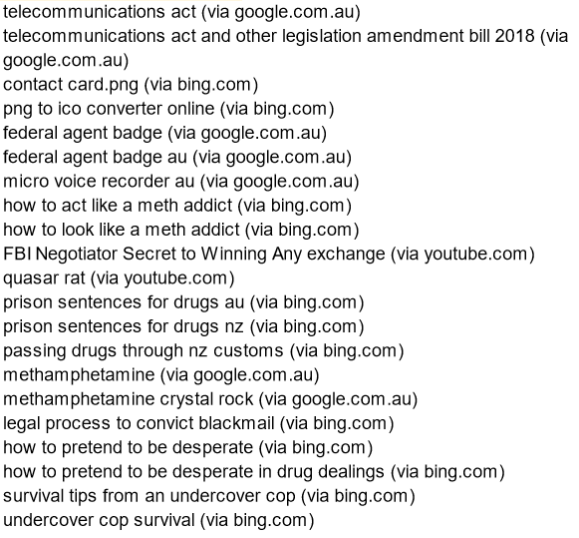
Exhibit B14 (Microsoft Edge History)
Preparation for contact with John by creating the keylogger
Preparation before the contact with John
Shows she was worried when John did not want new clients
Reaffirms her fear so she is searching for tips before she went on the trip
Jane's undercover role as a drug user allows her to gather vital information on John's illegal activities, aided by her use of deception and a micro voice recorder.

Slide 54
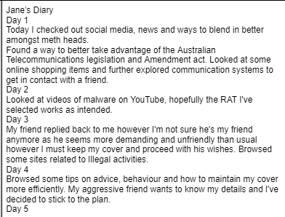
Exhibit B15 (Microsoft OneDrive Cache)
Her diary confirms her identity as a undercover officer taking cover

Slide 55
Analysis and Conclusion

Slide 56


Identity of Jane Esteban
Name: Jane Esteban
Suspected Role: Undercover Agent
Focus: Drug-related activities and crimes
Proficiency:
Despite some indications of uncertainty or inexperience, proficiency in using tools for information gathering.
The amount of information on her laptop and her handling of certain situations suggest competence beyond mere suspicion.

Slide 57
Identity of Jane Esteban
Possibility that the evidence indicating her AFP allegiance could be planted to mislead investigators, but the amount of information on her laptop and her handling of certain situations suggest otherwise.
Overall, the evidence strongly supports the conclusion that Jane Esteban is indeed an undercover agent for the AFP, tasked with uncovering and prosecuting individuals involved in drug-related activities.

Slide 58
2. What did John think of Jane?
What did John want from Jane?
Initially receptive to Jane Esteban's request for drugs but lost interest when she sent a file he couldn't open, indicating he viewed her as a potential drug buyer.
Proposed that Esteban accompany him on a business trip to New Zealand, showing he viewed Jane as gullible and wanted to use her to mask the trip as a couple holiday
Threatened harm to Jane Esteban's children when she refused, suggesting he saw her as vulnerable and manipulable.
Booked flights for their trip to Wellington, indicating he expected her compliance.
Notes:
Overall, John Fredricksen viewed Jane Esteban as someone he could manipulate and control for his own purposes, whether for drug transactions or as a companion to reduce suspicion during illicit activities.

Slide 59
3. Who were the guilty parties in the overall case?
1. Steve Kowhai:
Guilty of intent to traffic controlled substances, as evidenced by his intended receipt and redistribution of methamphetamine from John Fredricksen.
Suspected intent of manufacturing controlled substances, indicated by search history related to drug modification processes.
Suspected intent to commit acts of money laundering in conjunction with drug distribution.

Slide 60
3. Who were the guilty parties in the overall case?
2. John Fredricksen:
Guilty of trafficking in controlled substances, supported by evidence of his role as a supplier and distributor of drugs.
Guilty of import and export of controlled substances, demonstrated by possession and transportation of methamphetamine from Australia to New Zealand.

Slide 61
3. Who were the guilty parties in the overall case?
3. Jane Esteban:
Not assigned guilt based on evidence suggesting she provided intelligence to New Zealand Customs, leading to the apprehension of Fredricksen.
Diminished responsibility due to coercion by Fredricksen into accompanying him to New Zealand.
No direct possession of controlled substances and unclear awareness of Fredricksen's intentions.
Uncertain legality and admissibility of evidence obtained through covert installation of a remote administration tool on Fredricksen's laptop.

Slide 62
4. Guilty parties’ future plans and intentions based
1. Steve Kowhai:
Intended to scale up deliveries of methamphetamine from John Fredricksen for future shipments.
Planned to be involved in the process of "cutting" methamphetamine to enhance its effects or dilute its purity.
Intended to distribute the processed drugs, likely within Wellington, New Zealand and worldwide
Planned to engage in acts of money laundering with profits from drug sales, as indicated by his search history.

Slide 63
4. Guilty parties’ future plans and intentions based
2. John Fredricksen:
Likely to continue operations of supplying drugs
Envisioned scaling up drug supply operations, as suggested by conversation with Jane Esteban about having "bigger fish to fry" in Exhibit A12 (Discord Chat Logs), which could refer to Steve’s ambitious expansion plan seen in Exhibit A9 (Memo Things.odt)

Slide 64
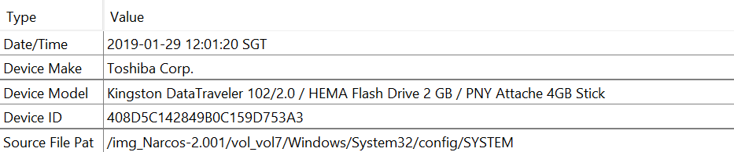
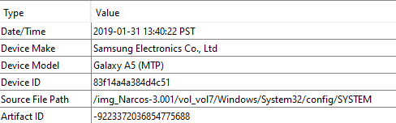
Further action
Find the thumb drive that was connected to John’s laptop and analyse for further details of his drug trafficking empire, likely found in his address in Inala
Obtain Mobile Device that was connected to Jane’s laptop and analyse for further communication between Jane and John

Slide 65
Further action
Access John’s Protonmail using his login credentials found in Jane’s Computer to find correspondences with his other clients
Being able to run volatility properly on memory dump might yield us more info but the memory dump given was unusable

Slide 66
Timeline
Legend:
Events are highlighted based on their source/evidence
Case Background/Information
Evidence/Conclusion from Case 1
Evidence/Conclusion from Case 2
2019-01-23
09:18:28 - John Fredricksen creates image of DHL shipping label, showing a package intended for Jake Heke in Auckland
2019-01-28
23:00:00: Steve Kowhai performs multiple searches on the internet relating the “cutting drugs”, and money laundering
2019-01-29
01:00:00 - Steve Kowhai performs multiple searches related to drug routes in Wellington and internationally
05:29:39 - Steve Kowhai initiates contact with John Fredricksen over Discord, with the message “Need to get a new delivery”
05:09:29 - Jane Esteban creates and compresses Quasar client as Contact Card.zip
11:29:13 - Jane Esteban initiates contact with John Fredricksen over Discord, with the message “Got any of that ice??”
11:32:45 - Jane Esteban sends Contact Card.zip to John
22:01:00 - John Fredricksen Downloads ZIP file
2019-01-30
Before 06:14:00 - John Fredricksen extracts and runs Contact Card.exe, the Quasar client connects to the server and starts recording key and mouse input information for the next 4 days
Before 07:40:00 - Steve Kowhai composes the Memo Things.odt file, creates an AES encrypted volume with TrueCrypt with the password “ilovediving”, and stores the word document within
07:40:00 - Steve Kowhai sends John Fredricksen the encrypted volume with instructions on how to access files within over email
08:00:16 - John Fredricksen downloads the attached encrypted volume from his email
08:04:00 - John Fredricksen decrypts the downloaded volume with TrueCrypt and accesses the Memo Things.odt contained within
All dates and times in the timeline of events will be stated in SGT (GMT+8)

Slide 67
Timeline
Legend:
Events are highlighted based on their source/evidence
Case Background/Information
Evidence/Conclusion from Case 1
Evidence/Conclusion from Case 2
2019-01-30
Before 06:14:00 - John Fredricksen extracts and runs Contact Card.exe, the Quasar client connects to the server and starts recording key and mouse input information for the next 4 days
Before 07:40:00 - Steve Kowhai composes the Memo Things.odt file, creates an AES encrypted volume with TrueCrypt with the password “ilovediving”, and stores the word document within
07:40:00 - Steve Kowhai sends John Fredricksen the encrypted volume with instructions on how to access files within over email
08:00:16 - John Fredricksen downloads the attached encrypted volume from his email
08:04:00 - John Fredricksen decrypts the downloaded volume with TrueCrypt and accesses the Memo Things.odt contained within
All dates and times in the timeline of events will be stated in SGT (GMT+8)

Slide 68
Timeline
Legend:
Events are highlighted based on their source/evidence
Case Background/Information
Evidence/Conclusion from Case 1
Evidence/Conclusion from Case 2
2019-01-31
05:00:00 - Steve Kowhai searches for multiple routes on Google maps (Wellington Airport to Eastbourne, location of Eastbourne Library, Wainuiomata to Eastbourne to Stokes Valley), and creates screenshots of each route.
08:22:19 - John Fredricksen threatens Jane Esteban with photos of her children, demanding that she follows him New Zealand to reduce suspicion on Fredricksen
09:59:00 - John Fredricksen performs multiple searches for terms relating to hiding of drugs and travel to Wellington
10:57:00 - Steve Kowhai performs multiple searches for drug paraphernalia
2019-02-01
07:02:24 - John Fredricksen takes photo of suitcase and packaged drugs, saved as package.jpg
07:05:17 - John Fredricksen creates image (BNE.png) hidden with package.jpg using the Image Steganography program
08:11:00 - John Fredricksen sends image hidden with packaged drugs and suitcase (BNE.png) to Steve Kowhai over email
All dates and times in the timeline of events will be stated in SGT (GMT+8)

Slide 69
Timeline
Legend:
Events are highlighted based on their source/evidence
Case Background/Information
Evidence/Conclusion from Case 1
Evidence/Conclusion from Case 2
2019-02-02
06:29:00 - John Fredricksen searches for flights from Brisbane to Wellington
08:02:08 - John Fredricksen books flights to Wellington, New Zealand and instructs Jane Esteban to meet at 133 Oxley Station Road on the day of the flight
10:30:36 - Steve Kowhai informs John Fredricksen to meet at Eastbourne Library or alternatively 666 Rewera Avenue
2019-02-16
06:45:00 - Jane Esteban and John Fredricksen departs on a flight from Brisbane bound for Wellington
11:15:00 - Jane Esteban and John Fredricksen arrive in Wellington, subsequently arrested and questioned by Customs
2019-02-23
02:15:00 - John Fredricksen and Jane Esteban are scheduled to depart Wellington, New Zealand en route to Brisbane, Australia, with a stopover at Auckland, New Zealand
All dates and times in the timeline of events will be stated in SGT (GMT+8)

Slide 70
Any Questions?

